Slide 1
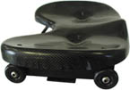
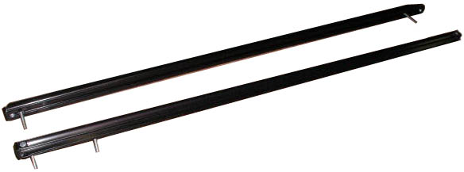
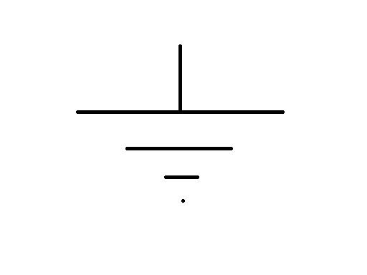
Trial 1 – Unsuccessful - Slide Timing
Using a potentiometer on the crew shell slide, it can be determined where a metal brush is located. This is done by measuring
the resistance of the slide, scale and shifting the output voltage, and displaying it on our digital coxswain display panel.
As the seat moves to the right, the
resistance caused by the length of the
slide to the left of the brush will cause
a linear voltage to position relationship.
This relationship can be measured, scale
and shifted, and displayed showing exactly
where every rower in the crew shell is
located on the slide at any given time.
An electrical connection consisting of
a straight wire will connect the two
input and output brushes across
the rowers seat.
Metal brush to make electrical contact to output track
+5V
Source Voltage
Metal Brush to make electrical contact to conductive track
Ground
Output Track. Will read voltage from output track as it will be connected through the seat to the potentiometer on the input track
ENCL-1

